Slide 1
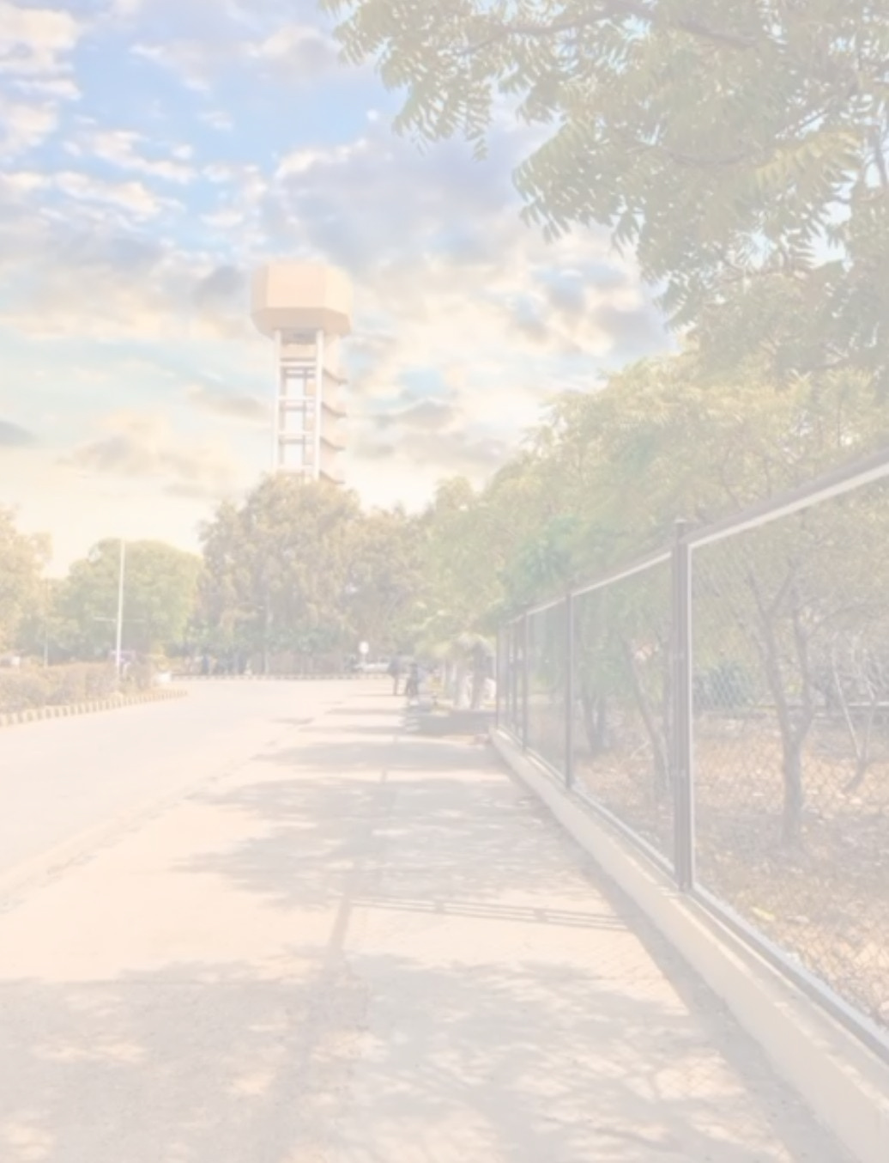
SIMULATION GPS NAVIGATION SYSTEM FOR NED
BY :
MARYAM ASHRAFF (DT-22050)
DANIA KARRAR (DT-22007)
HIBA KAZMI(DT-22025)
TASKEEN SADIQ(DT-22004)

Slide 2
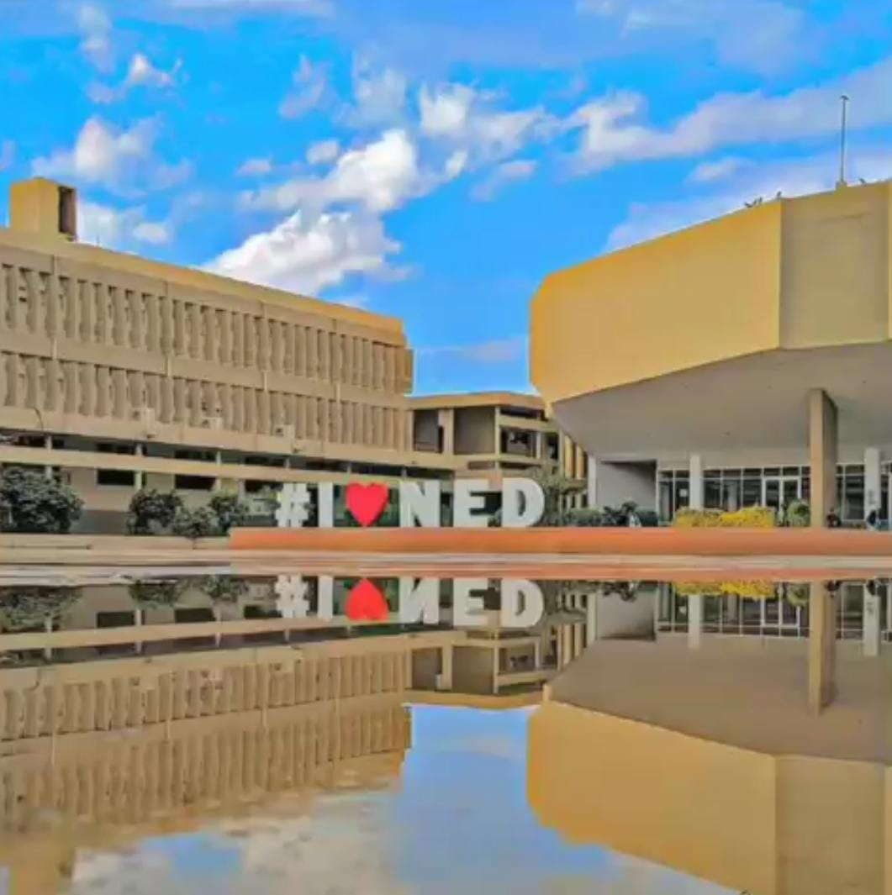
Problem Statement
The NED University campus currently lacks a dedicated navigation system to help students, faculty, and visitors find optimal routes across the campus. Without a digital guide, navigating the area—especially for newcomers—can be confusing and time-consuming. There is a need for a smart, campus-specific navigation solution that provides both shortest and comfort-based paths using static map data.

Slide 3
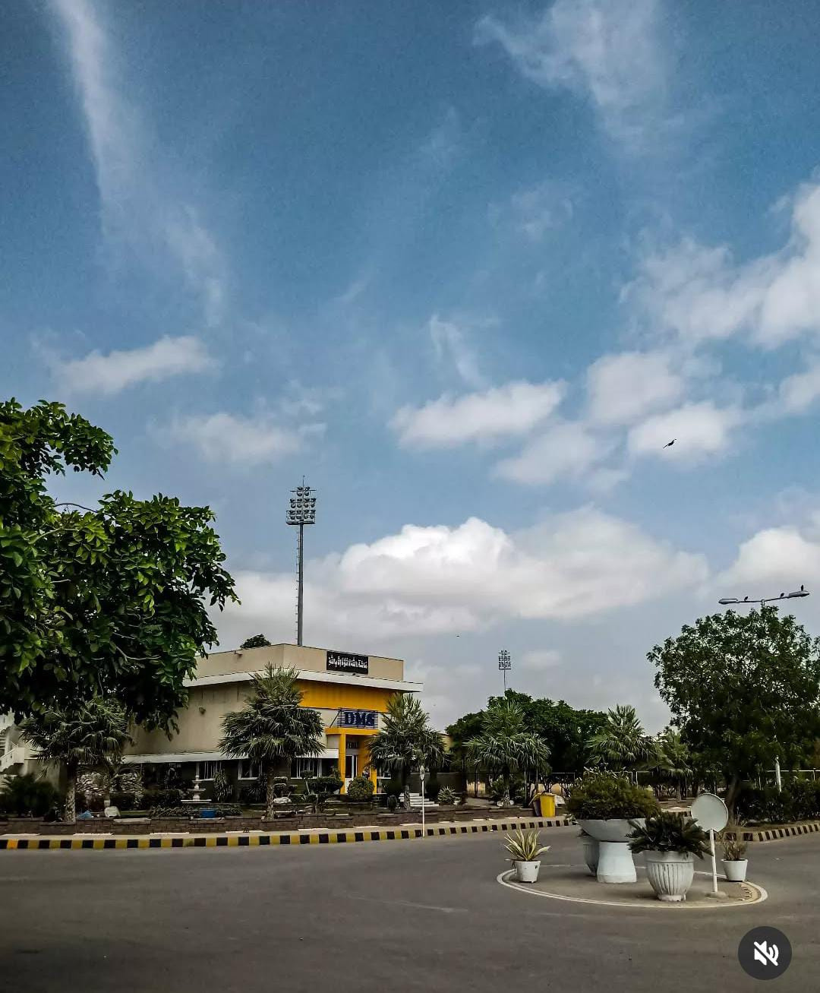

Objective
To develop a smart navigation system specifically for the NED University campus using static map data.
This system is designed to enhance user experience by not only guiding them efficiently across campus but also considering personal comfort during navigation. By simulating real-world routing behavior through static data, it serves as a practical and scalable solution for controlled environments like university campuses.
To implement routing algorithms (A* and Dijkstra) for calculating both shortest and comfort-based paths.
To assist students, faculty, and visitors in easily navigating the campus without the need for live GPS data.

Slide 4
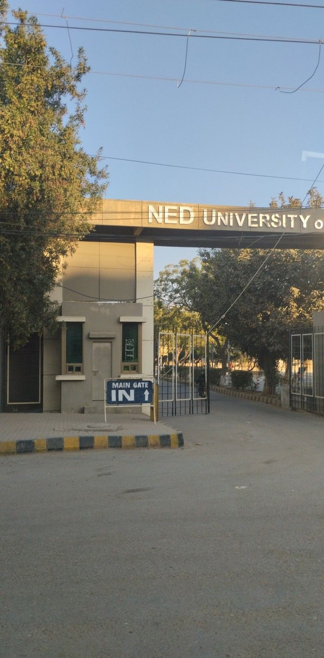
Architecture Components
Static Data (JSON FILE)
Routing Algorithm (JavaScript)
User Interface (Frontend)
Built with React + Vite
Accepts start and end point input
Displays routes visually (map, lines, etc.)
Nodes: Represent locations (e.g., buildings, gates)
Edges: Represent connections (with distance, time, comfort)
A* for shortest path
Dijkstra for comfort-based path

Slide 5
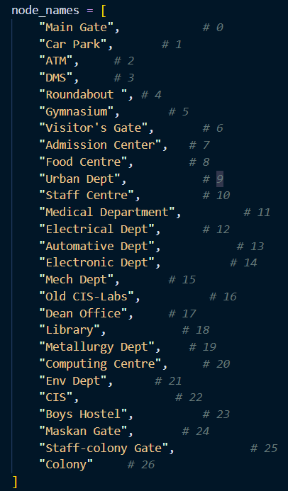
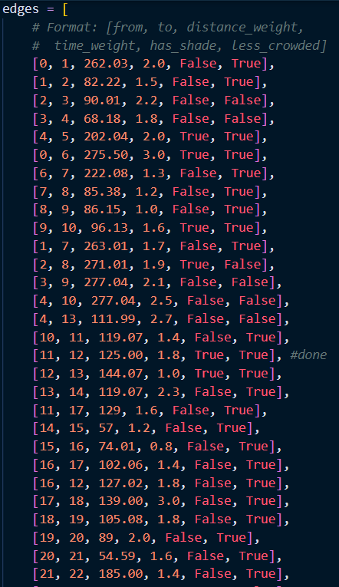
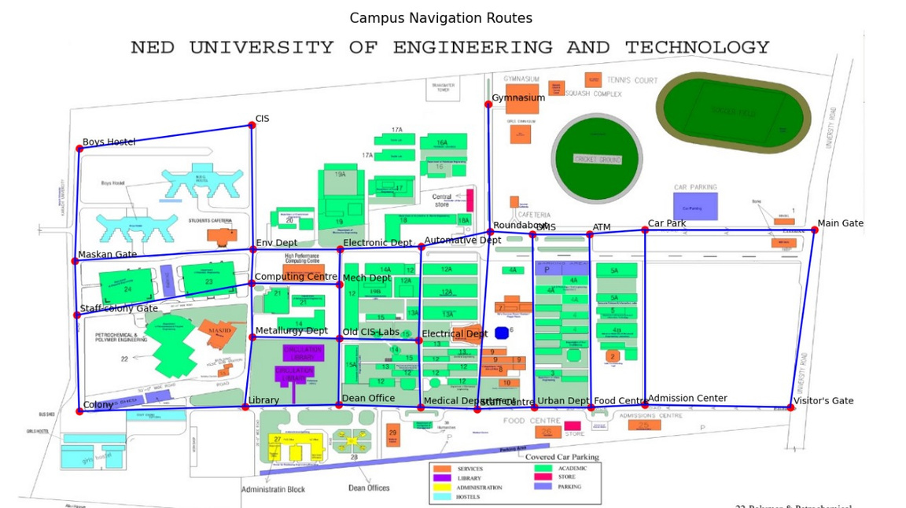
Static Data (JSON FILE)

Slide 6
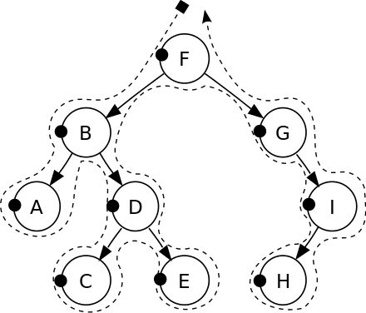
Routing Algorithms
Problem
Find the best route between two points on a map, based on specific criteria (shortest, most comfortable).
Possible Algorithms
Breadth-First Search (BFS) – only works on unweighted graphs.
Dijkstra’s Algorithm – optimal for weighted graphs without heuristics.
Bellman-Ford – handles negative weights but slower.
A* Algorithm – uses heuristics for faster decisions.

Slide 7
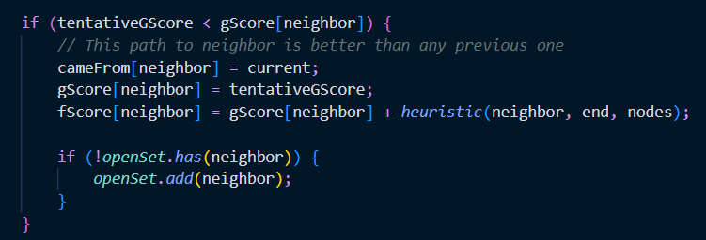
A* Algorithm – Shortest/Time-Based Pathfinding
Purpose: Used to find the shortest or fastest path by combining real cost + heuristic.
Pseudocode (simplified):
Initialize open set with start node
Loop:
Choose node with lowest f(n)
Update neighbors’ scores
Add them to open set if better path found
3. Return path when end node reached
Heuristic Formula: f(n)=g(n)+h(n)

Slide 8
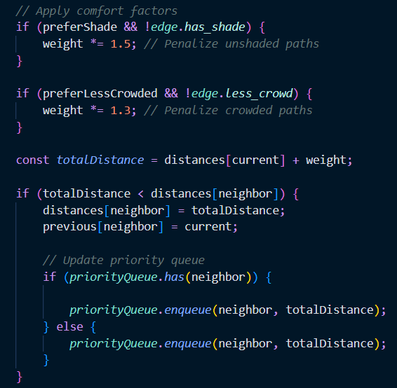
Dijkstra’s Algorithm – Comfort-Based Routing
Purpose: Used to find the most comfortable route based on shade and crowd level.
Pseudocode (simplified):
Initialize all distances = ∞
Set start distance = 0
Loop:
Visit nearest unvisited node
Update neighbor distances based on comfort weights

Slide 9
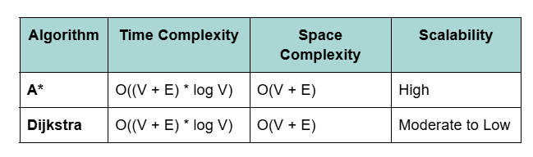
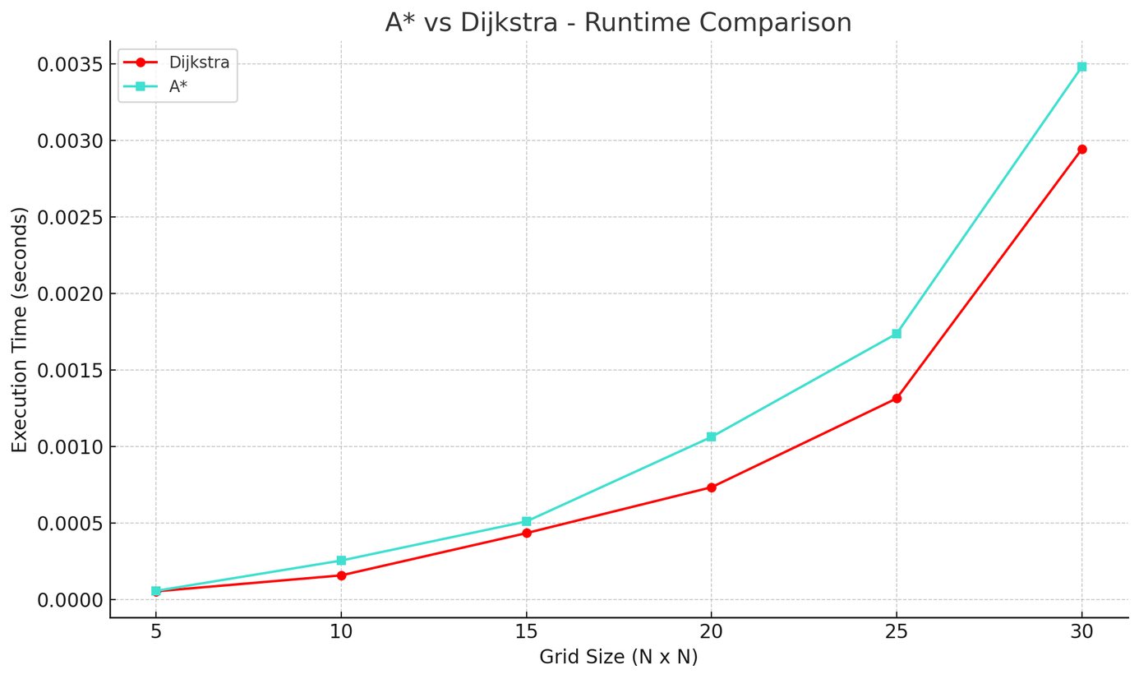
Time, Space Complexity & Scalability

Slide 10
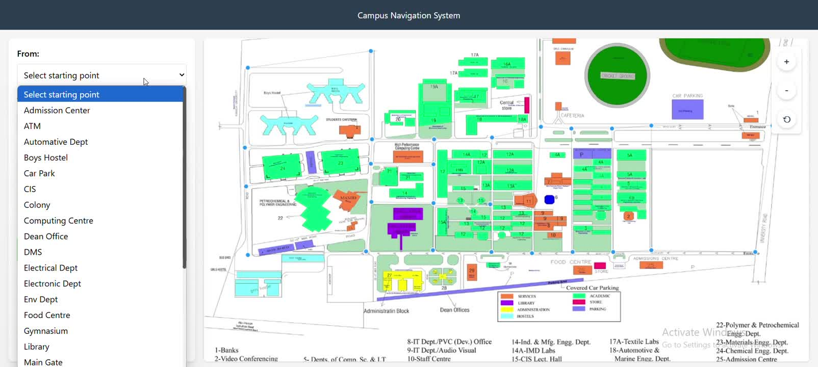

User Interface

Slide 11
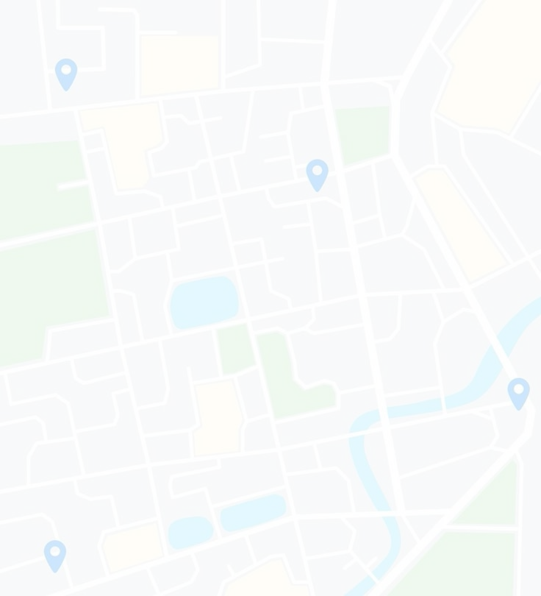
Real-World Applications
Campus Navigation Apps: For universities, hospitals, or large corporate campuses where GPS isn't precise indoors or where custom routing (e.g., ramps vs stairs) is needed.
Event Management: Helps guide attendees at conferences, expos, or festivals with customized paths (e.g., shaded, less crowded).
Smart City Planning: Can assist urban planners in modeling pedestrian flow, comfort routing, and accessibility before implementation.
Tourism & Museums: Guides visitors through optimized routes based on interest, accessibility, or comfort in large attractions.
Disaster Response: Used for safe routing in emergency situations, factoring blocked paths, shade, or safety levels.

Slide 12
Thank you very much!

